Slide 1
Lecture 7: Intermediate SQL

Slide 2
Chapter 4: Intermediate SQL
Outer Joins
Views and Materialized Views
Cascading Actions
Notes:
1

Slide 3
Joined Relations
Join operations take two relations and returns another relation.
A join operation is a Cartesian product which requires that tuples in the two relations match (under some condition). It also specifies the attributes that are present in the result of the join
The join operations are typically used as subquery expressions in the from clause

Slide 4
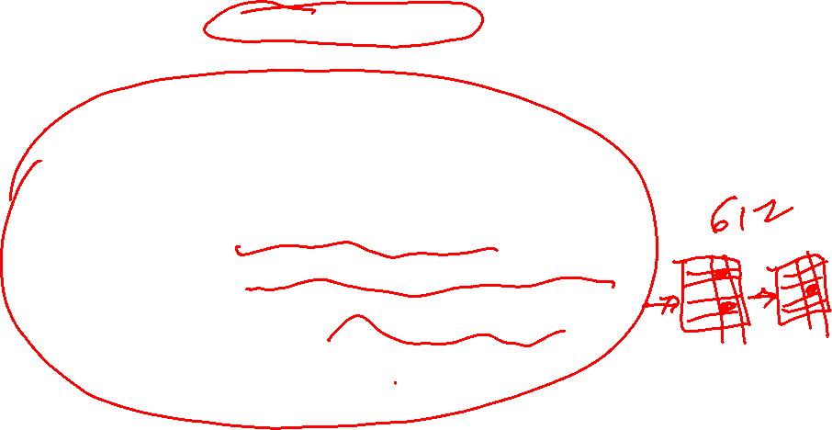
Types of Join: Self join
Self Join: A self join is a join in which a table is joined with itself
SELECT column_name(s) FROM table1 T1, table1 T2 WHERE T1.common_field = T2.common_field;
Example1: Find customers living in same zipcode
SELECT Distinct B.cus_lname, B.cus_areacode
FROM customer A, customer B
WHERE A.cus_areacode = B.cus_areacode
AND A.cus_code != B.cus_code
ORDER BY 1;

Slide 5

Types of Join: Self join
Example 2: Find employees and their supervisors
SELECT a.emp_id AS "Emp_ID",
a.emp_name AS "Employee Name",
b.emp_id AS "Supervisor ID",
b.emp_name AS "Supervisor Name"
FROM employee a, employee b
WHERE a.emp_supv = b.emp_id
AND a.emp_id != b.emp_id;

Slide 6
Types of Join: Natural join
Natural Join:
Links tables by selecting rows that have common values in their common attributes
Schema of the output is same as that of cross-product.
Fewer tuples than cross-product, might be able to compute efficiently
Question: What happens if one of the tables has no matching row in other table?

Slide 7
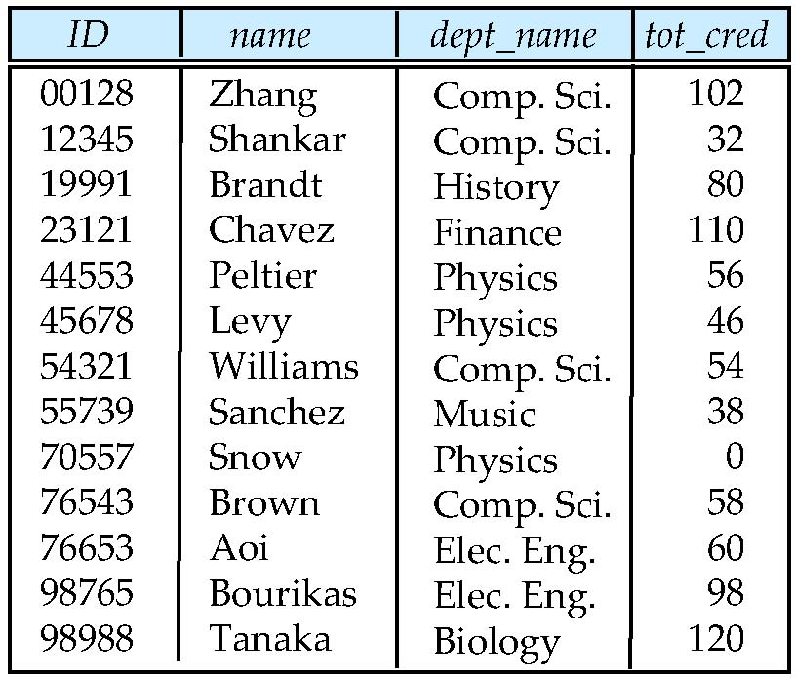
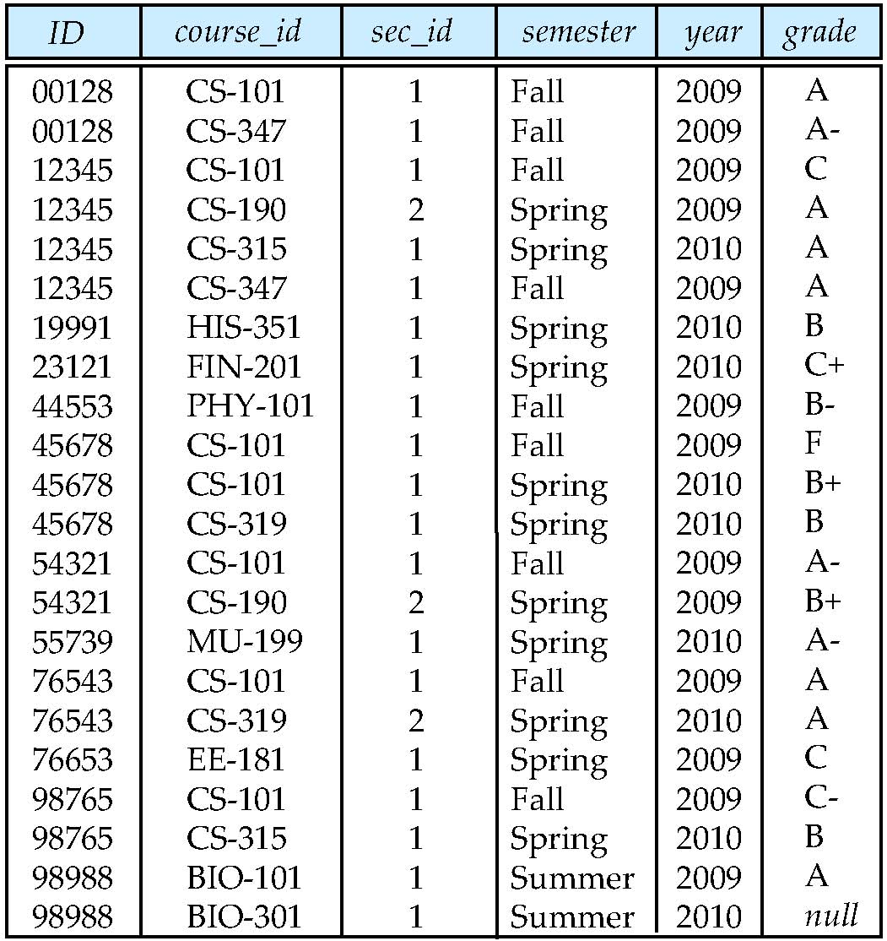

Joined Relations
student
takes
select *
from student S,takes T
where S.ID = T.ID

Slide 8
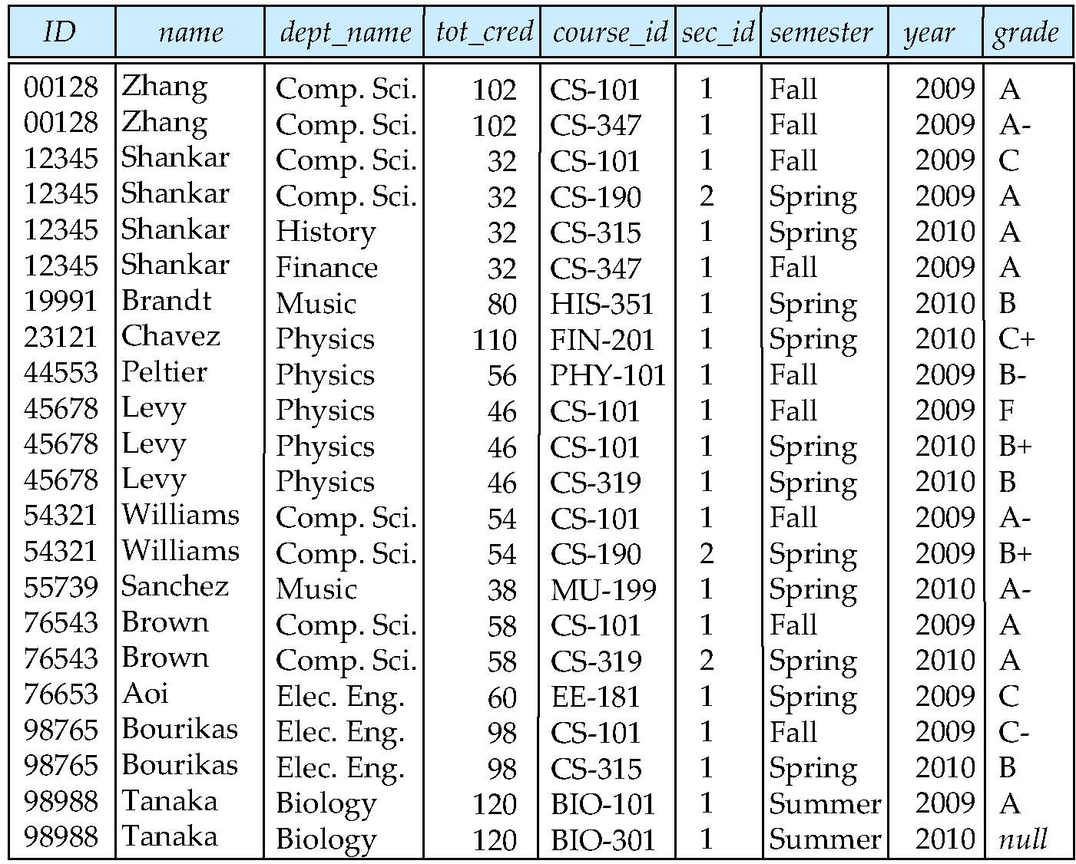
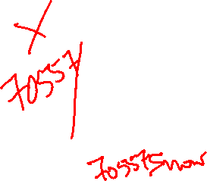
Joined Relations
Where is 70557 / Snow / Physics / 0 ?

Slide 9

Outer Join
An extension of the join operation that avoids loss of information.
Computes the join and then adds tuples from one relation that does not match tuples in the other relation to the result of the join.
Uses null values to fill attributes that do not have values.

Slide 10
Outer Join (Contd. )
Outer Join - Natural join with inclusion of tuples that do not have a match
Three types:
Left outer join:
Natural Join AND include all rows from the table in the left side even the rows that do not have a match
Example: include all customers even those which do not have a matching agent
Right outer join:
Natural join AND include all rows from the table in the right side even the rows that do not have a match
Example: include all agents don’t have a matching customers
Full outer join:
Natural join and include all tuples from both sides even the tuples that do not have a match

Slide 11
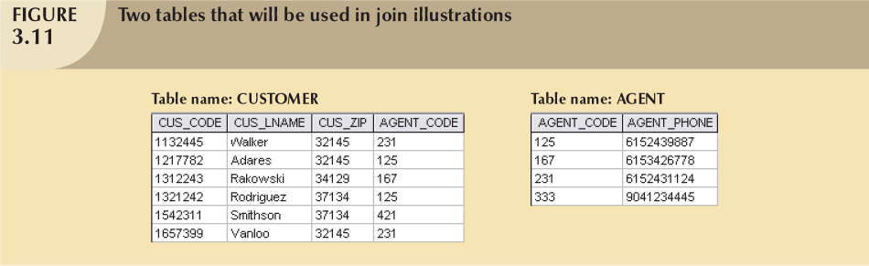
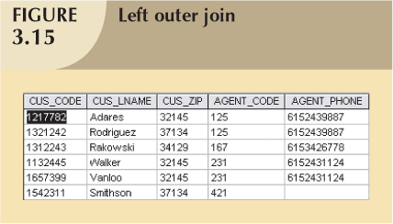
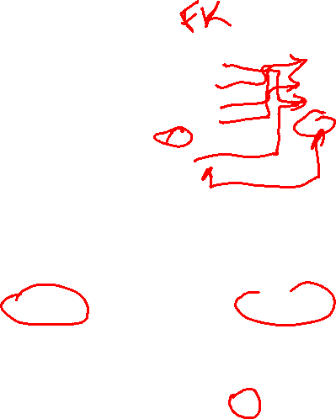
Left Outer Join
null
null
null

Slide 12
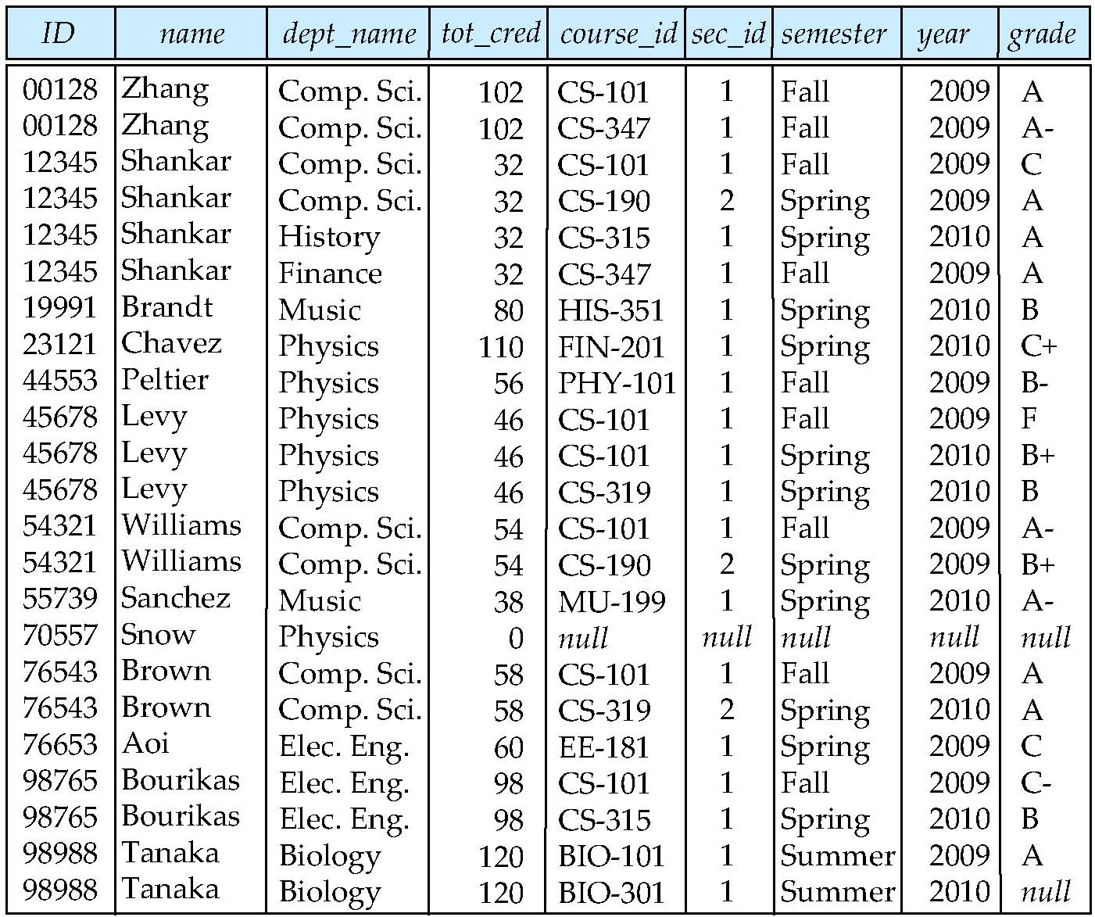
select *
from student S left outer join takes T on (S.ID = T.ID)

Slide 13
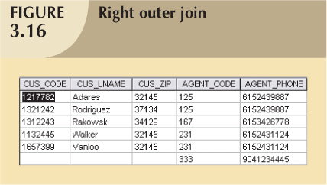

Right Outer Join
null
null
null

Slide 14
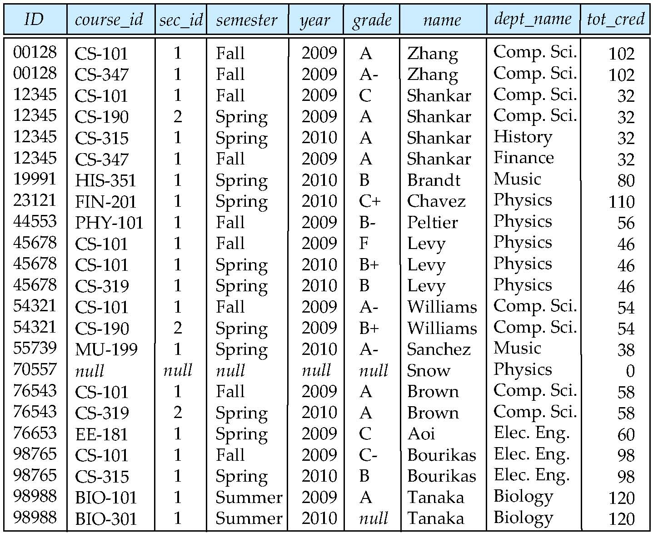

select *
from takes T right outer join student S on (S.ID = T.ID)

Slide 15
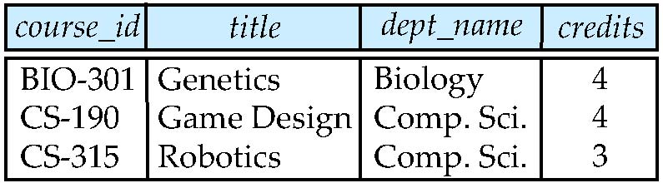
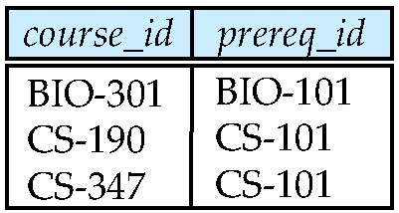
Join operations – Example
Relation course
Relation prereq
Observe that
prereq information is missing for CS-315 and
course information is missing for CS-347

Slide 16
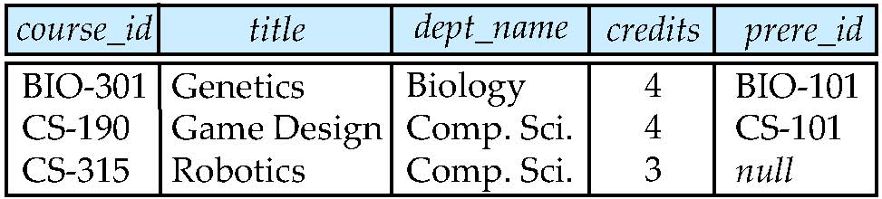

Left Outer Join
course natural left outer join prereq
select *
from course C left outer join prereq P on (C.course_id = P.course_id)

Slide 17
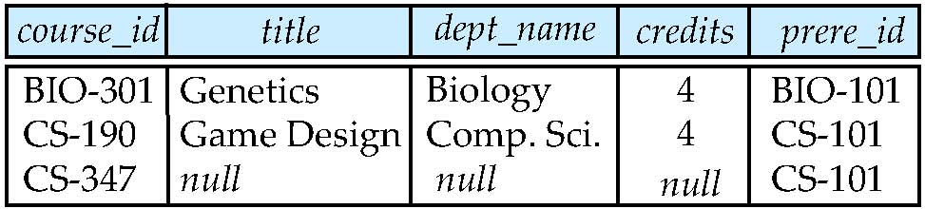
Right Outer Join
course natural right outer join prereq
select *
from prereq P right outer join course C on (C.course_id = P.course_id)

Slide 18
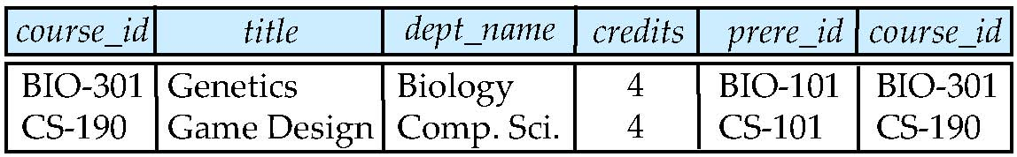
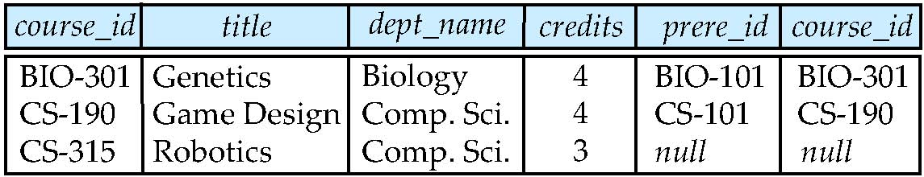

Joined Relations – Examples
course inner join prereq on course.course_id = prereq.course_id
What is the difference between the above, and a natural join?
course left outer join prereq on course.course_id = prereq.course_id

Slide 19
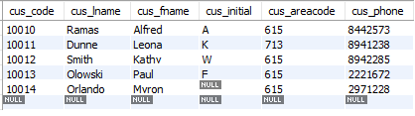
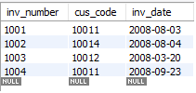
Class Exercise - JOIN
Customer
Invoice
Use left join to match invoices with customers
Use right join to match invoices with customers
select *
from customer C left outer join invoice I on C.cus_code = I.cus_code;
select *
from customer C right outer join invoice I on C.cus_code = I.cus_code;

Slide 20
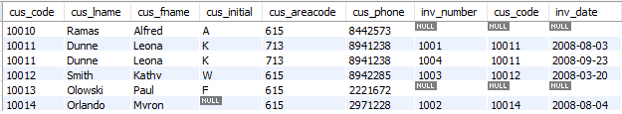
Class Exercise - JOIN
Customer
Invoice
select *
from customer C left outer join invoice I on C.cus_code = I.cus_code;

Slide 21

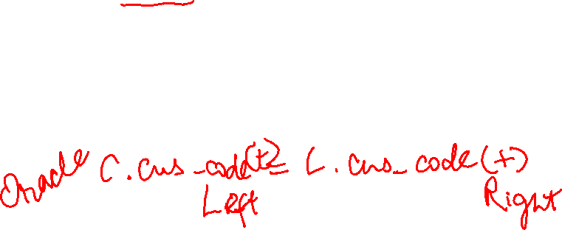
Class Exercise - JOIN
Customer
Invoice
select *
from customer C right outer join invoice I on C.cus_code = I.cus_code;

Slide 22

Views
In some cases, it is not desirable for all users to see the entire logical model (that is, all the actual relations stored in the database.)
Consider a person who needs to know an instructors name and department, but not the salary. This person should see a relation described, in SQL, by select ID, name, dept_name from instructor
A view provides a mechanism to hide certain data from the view of certain users.
Any relation that is not of the conceptual model but is made visible to a user as a “virtual relation” is called a view.

Slide 23
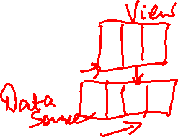
View Definition
A view is defined using the create view statement which has the form
create view view_name as < query expression >
where <query expression> is any legal SQL expression. The view name is represented by view_name.
Once a view is defined, the view name can be used to refer to the virtual relation that the view generates.
View definition is not the same as creating a new relation by evaluating the query expression
Rather, a view definition causes the saving of an expression; the expression is substituted into queries using the view.

Slide 24
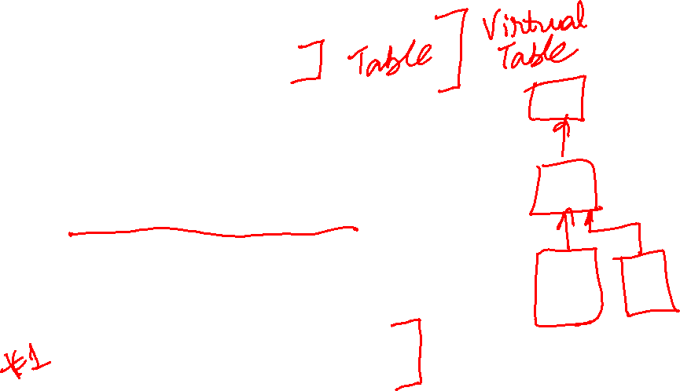
Example Views
A view of instructors without their salary create view faculty as select ID, name, dept_name from instructor;
A view of all instructors in the Biology department create view biologyFaculty as
select name from instructor where dept_name = ‘Biology’
Create a view of department salary totals create view departments_total_salary (dept_name, total_salary) as select dept_name, sum (salary) from instructor group by dept_name;

Slide 25

Views Defined Using Other Views
create view cs_spring_2010 as select course.course_id, sec_id, building, room_number from course, section where course.course_id = section.course_id and course.dept_name = ‘Comp. Sci.’ and section.semester = ’Spring’ and section.year = ’2010’;
create view cs_spring_2010_watson as select course_id, room_number from cs_spring_2010 where building= ’Watson’;

Slide 26

Update of a View
Add a new tuple to faculty view which we defined earlier
insert into faculty values (‘30765’, ‘Green’, ‘Music’);
This insertion must be represented by the insertion of the tuple
(’30765’, ’Green’, ’Music’, Null)
into the instructor relation
Above Insert is equivalent to:
insert into instructor(ID, Name, Dept_name, salary)
values (‘30765’, ‘Green’, ‘Music’, Null);

Slide 27

Some Updates cannot be Translated Uniquely
create view instructor_info as select ID, name, building from instructor I, department D where I.dept_name= D.dept_name;
insert into instructor_info values (’69987’, ’White’, ’Taylor’);
which department, if multiple departments in Taylor?
what if no department is in Taylor?

Slide 28

And Some Not at All
create view history_instructors as select * from instructor where dept_name= ’History’;
What happens if we insert (’25566’, ’Brown’, ’Biology’, 100000) into history_instructors?
Check view history_instructors
Check table instructor

Slide 29
Restrictions on Updating Views
Most SQL implementations allow updates only on simple views
The from clause has only one table
The select clause contains only attribute names of the table, and does not have any expressions, aggregates, or distinct specification.
Any attribute not listed in the select clause can be set to null
The query does not have a group by or having clause.

Slide 30

Materialized Views
Materializing a view: create a physical table containing all the tuples in the result of the query defining the view
If relations used in the query are updated, the materialized view result becomes out of date
Need to maintain the view, by updating the view whenever the underlying relations are updated.
Why materialized views?
Useful when views have complex and time consuming SQL

Slide 31
Maintenance of Materialized views
Cost vs. Gain?
How often to update the view?
Instant
lazily
Periodically

Slide 32
Why to use Views?
Security and Privacy
Create personalized views of data
Better performance (with materialized views)

Slide 33

Cascading Actions in Referential Integrity
create table course ( course_id char(5) primary key, title varchar(20),
dept_name varchar(20), foreign key dept_name varchar(20) references department)
create table course ( … dept_name varchar(20), foreign key (dept_name) references department on delete cascade on update cascade, . . . )

Slide 34
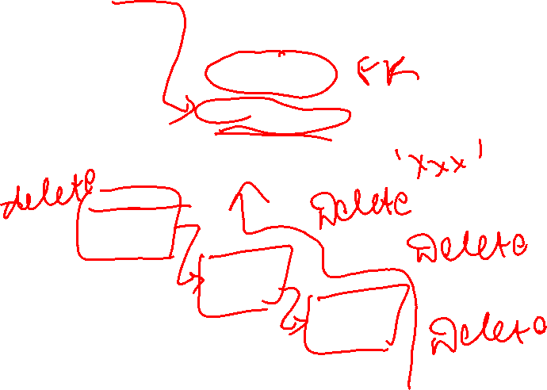
Foreign Key Actions
on delete
on update
set null
cascade
set default

Slide 35

Examples
foreign key (inv_number) references invoice (inv_number) on delete cascade
Ensures that if you delete any invoice, the corresponding invoice lines are automatically deleted
Ensures that the referential integrity is maintained
foreign key (vend_code) references vendor (vend_code) on update cascade
Ensures that if you make a change in any vendor’s V_CODE that change is automatically applied to all products
Ensures that the referential integrity is maintained
You can not delete a vendor row as long as there is a product row that refers to it

Slide 36
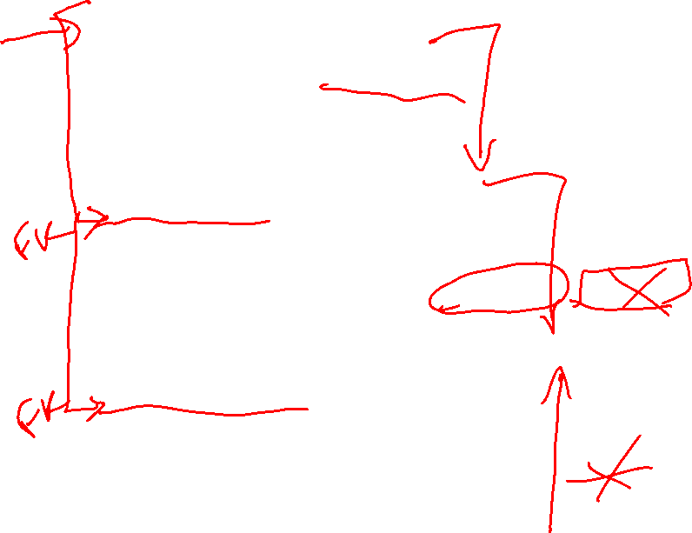
Example1 – No Cascades
create table department1
(dept_name varchar(20),
building varchar(15),
budget numeric(12,2) check (budget > 0),
primary key (dept_name)
);
create table course1
(course_id varchar(8),
title varchar(50),
dept_name varchar(20),
credits numeric(2,0) check (credits > 0),
primary key (course_id),
foreign key (dept_name) references department1 (dept_name)
);
create table instructor1 (id varchar(5),
name varchar(20) not null,
dept_name varchar(20),
salary numeric(8,2) check (salary > 29000),
primary key (ID),
foreign key (dept_name) references department1 (dept_name)
);

Slide 37
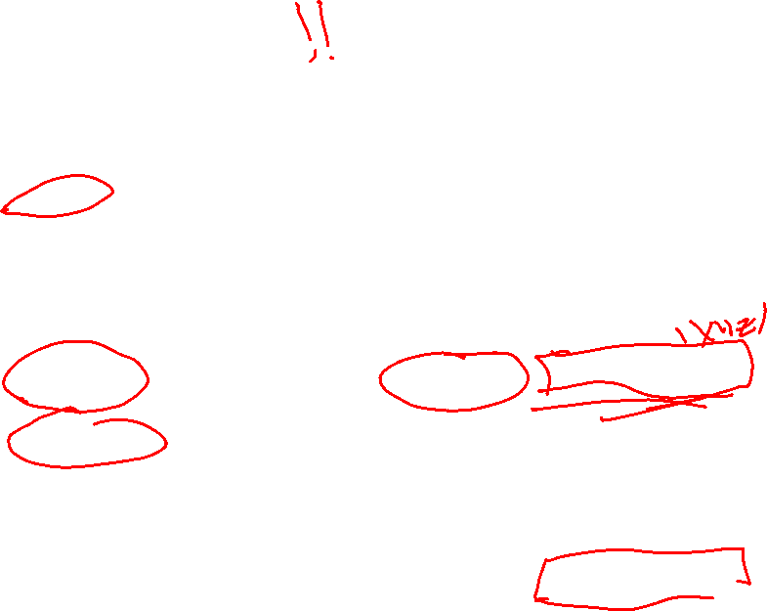
Example2 – On Delete Set Null
create table department2
(dept_name varchar(20),
building varchar(15),
budget numeric(12,2) check (budget > 0),
primary key (dept_name)
);
create table course2
(course_id varchar(8),
title varchar(50),
dept_name varchar(20),
credits numeric(2,0) check (credits > 0),
primary key (course_id),
foreign key (dept_name) references department2 (dept_name) on delete set null );
create table instructor2 (id varchar(5),
name varchar(20) not null,
dept_name varchar(20),
salary numeric(8,2) check (salary > 29000),
primary key (ID),
foreign key (dept_name) references department2 (dept_name) on delete set null );

Slide 38
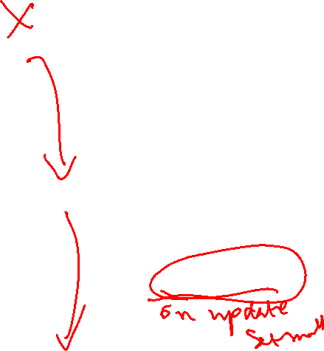
Example3 – On Delete Cascade
create table department3
(dept_name varchar(20),
building varchar(15),
budget numeric(12,2) check (budget > 0),
primary key (dept_name));
create table course3
(course_id varchar(8),
title varchar(50),
dept_name varchar(20),
credits numeric(2,0) check (credits > 0),
primary key (course_id),
foreign key (dept_name) references department3 (dept_name) on delete cascade );
create table instructor3 (id varchar(5),
name varchar(20) not null,
dept_name varchar(20),
salary numeric(8,2) check (salary > 29000),
primary key (ID),
foreign key (dept_name) references department3 (dept_name) on delete cascade);

Slide 39

Authorization
Forms of authorization on parts of the database:
Select - allows reading, but not modification of data.
Insert - allows insertion of new data, but not modification of existing data.
Update - allows modification, but not deletion of data.
Delete - allows deletion of data.
Forms of authorization to modify the database schema
Index - allows creation and deletion of indices.
Resources - allows creation of new relations.
Alteration - allows addition or deletion of attributes in a relation.
Drop - allows deletion of relations.

Slide 40

Authorization Specification in SQL
The grant statement is used to confer authorization
grant <privilege list>
on [schema.]<relation name or view name> to <user list>
<user list> is:
a user-id
public, which allows all valid users the privilege granted
A role (more on this later)
Granting a privilege on a view does not imply granting any privileges on the underlying relations.
The grantor of the privilege must already hold the privilege on the specified item (or be the database administrator).

Slide 41

Privileges in SQL
select: allows read access to relation,or the ability to query using the view
Example: grant users U₁, U₂, and U₃ select authorization on the instructor relation:
grant select on instructor to U₁, U₂, U₃
insert: the ability to insert tuples
update: the ability to update using the SQL update statement
delete: the ability to delete tuples.
all privileges: used as a short form for all the allowable privileges
To get a complete list of privileges and grants:
Show privileges;
Show grants;

Slide 42
Examples of Privileges in SQL
Grant select on customer to user1;
Grant insert on customer to user1;
Grant update on customer to user1;
Grant delete on customer to user1;
Grant Index on customer to user1, user2;
Grant Resources on customer to user1, user2;
Grant Alteration on customer to user1, user2;
Grant Drop on customer to user1, user2;

Slide 43
Revoking Authorization in SQL
The revoke statement is used to revoke authorization.
revoke <privilege list>
on <relation name or view name> from <user list>
Example:
revoke select on branch from U₁, U₂, U₃
<privilege-list> may be all to revoke all privileges the revokee may hold.
If <revokee-list> includes public, all users lose the privilege except those granted it explicitly.
If the same privilege was granted twice to the same user by different grantees, the user may retain the privilege after the revocation.
All privileges that depend on the privilege being revoked are also revoked.

Slide 44

Roles
create role instructor;
grant instructor to Sarah;
Privileges can be granted to roles:
grant select on takes to instructor;
Roles can be granted to users, as well as to other roles
create role teaching_assistant
grant teaching_assistant to instructor;
Instructor inherits all privileges of teaching_assistant
Chain of roles
create role dean;
grant instructor to dean;
grant dean to Satoshi;

Slide 45
Authorization on Views
create view geo_instructor as (select * from instructor where dept_name = ’Geology’);
grant select on geo_instructor to geo_staff
Suppose that a geo_staff member issues
select * from geo_instructor;
What if
geo_staff does not have permissions on instructor?
creator of view did not have some permissions on instructor?

Slide 46

Other Authorization Features
references privilege to create foreign key
grant reference (dept_name) on department to Mariano;
why is this required?
transfer of privileges
grant select on department to Amit with grant option;
revoke select on department from Amit, Satoshi cascade;
revoke select on department from Amit, Satoshi restrict;
Etc. read Section 4.6 for more details we have omitted here.

Slide 47
Reading and Assignment
No. | Date | Topics and Required Reading | Assignments
 |  |  |  | start of class day

